Slide 1

Mental Illness Detection
from Social Media Activities using NLP
Anh Nguyen, Hanna Song

Slide 2
Research Question
Research question:
Can mental illness be predicted by people's negative expressions/behaviors on social media?
Hypothesis:
By examining users' behavior on social media, we can detect their potential susceptibility to experiencing mental health disorders

Slide 3
Key Constructs and
their Relationships
Key Constructs:
Social Media use
Post trends
Number of engagements
Accuracy of predictability of mental illness
Relationship: Causal
Constructs 1, 2 and 3 cause construct 4
Frequency of reddit usage, readability assessment (i.e automated readability index), and text classification (content analysis and sentiment of texts) can indicate detection of mental illness of reddit users

Slide 4
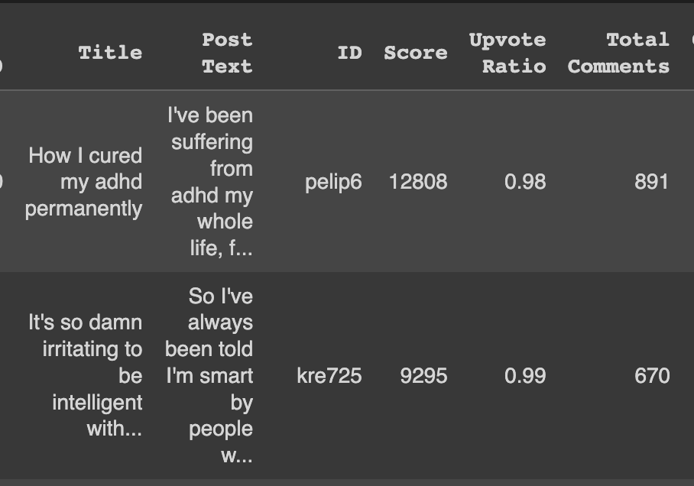
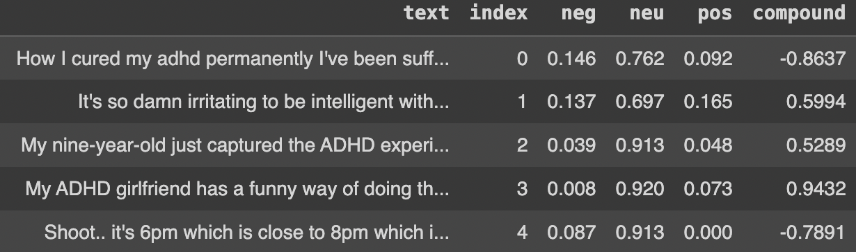
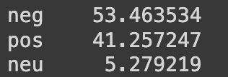
Features in Pilot Data
Title
Post Text
ID (User ID)
Score
Upvote Ratio
Total Comments
Added new feature using NLP:
Compound - with threshold 0.05
sum of the polarity of the text (negative, neutral, positive) to provide an degree of the sentiment of the text
Notes:
more features in pilot data: Created On (date) , Post URL, Original Content, Saved, name of subreddit

Slide 5
Features to Constructs
Construct | Feature
Frequency of reddit usage | Score, User ID
Readability of posts | Title, Post text, Total comments, Upvote ratio
Emotionality of posts | Compound sentiment score
Prediction of Mental illness | Construct 1 to 3 (no assigned feature yet)
Notes:
These are the relevant features that we're going to analyze with regards to our constructs

Slide 6
Feature Analysis
Justification
Nominal: text/labels that do not have a natural order or ranking before processing
Ratio: In readability and emotionality of posts, there is order and the difference between values matter in measurement, has an absolute zero
Title: nominal
Post text: nominal
User ID: nominal
Score: ratio
Upvote Ratio: ratio
Total Comments: ratio
Compound Sentiment Scores: ratio
Notes:
Nominal- back number of football
Ordinal- ordered, this data < that data,ordered logistic regression, class each items
Interval - distance, continuous
Ratio - absolute zero , temperature (klevin is only)

Slide 7
Feature Validity
Construct | Feature | Validity
Frequency of reddit usage | Score, User ID | Face validity Shows how much users contribute to subreddits
Readability of posts | Title, Post text, Total comments, Upvoted ratio | Concurrent validity, content validity, face validity Title and post text: measure text length, language and vocab, context and tone Total comments, upvoted ratio: measure engagements
Emotionality of posts | Compound (pos/neg/neu) | Convergent-discriminant validity, content validity, face validity Measure either sentiment indication and intensity of posts: if sample posts are negative > mental illness predictability
Prediction of Mental illness | Construct 1 to 3 | Predictive validity, face validity Uses sentiment analysis and readability analysis to detect mental illness tendency of users
Notes:
concurrent validity - measure the same constructs with title and post and total comments and upvoted ratio
content vallidtiy -

Slide 8
Convergent-Discriminant Validity
Construct | Feature | Convergent-Discriminant Validity
Frequency of reddit usage | Score, User ID | Convergent when users have high score and high frequency of posting on reddit Discriminant when users have low score and low frequency of posting on reddit
Readability of posts | Title, Post text, total comments, upvoted ratio | Convergent when readability score, total comments and upvote ratio are high Discriminant when readability score, total comments and upvote ratio are low
Emotionality of posts | Compound | Convergent when posts have high negative scores Discriminant when there are no correlation or more positive posts
Prediction of Mental illness | Construct 1 to 3 | Convergent when negative sentiment score and readability score are high Discriminant when negative sentiment score and readability score are low
Notes:
readability: Flesch-Kincaid Readability Index, gunning fog index, or coleman-liau index, and automated readability index, sentence length, lexicon
when posts are negatively correlated and discriminant when there are any correlations or more positive posts

Slide 9
Quantification of Measurement Error
Feature | Measurement | Quantification of Measurement Error
Title, Post texts | Direct reflection and detailed information of the content or topic being discussed → There can be some degree of ambiguity or subjectivity in interpreting texts | Use statistical methods Cohen’s Kappa to determine reliability
User ID | Unique for all users → reliable by themselves | Ensure that the data collection and cleaning processes are accurate
Score | Indication of posts' popularity and relevance within the communities | Conduct a reliability analysis

Slide 10
Quantification of Measurement Error
Feature | Measurement | Quantification of Measurement Error
Upvote Ratio | Representation of community's sentiment towards a post | Analyzing variability over time
Compound Sentiment Scores | Comprehensive measure of sentiment in a post | Ensure the data preprocessing and sentiment analysis are well prepared and accurate

Slide 11
Potential Methodological Biases
Title: May not accurately represent the content or contain triggering/sensational language that attracts other users
Post text: Length and content of post text may vary widely
> Mitigation Plan:
Consider using natural language processing techniques to extract key features or sentiments from the text.
Randomly sample posts to ensure a representative dataset.
Score: Popular or controversial posts may receive a higher score
> Mitigation Plan:
Normalize scores
Use statistical techniques (e.g., regression analysis) to control for the influence of score on the analysis
Notes:
Normalize scores by the total number of votes to IDs for variations in post popularity; Use statistical techniques (e.g., regression analysis) to control for the influence of score on the analysis

Slide 12
Potential Methodological Biases
Upvote Ratio: Different subreddits may have varying standards for upvoting
> Mitigation Plain:
Include subreddit name as a categorical variable in the analysis to account for community-specific biases (subreddit name column)
Consider using the upvote ratio relative to the subreddit it belongs to, rather than an absolute measure.
Total Comments: Controversial topics may generate more comments
> Mitigation Plan:
Normalize total comments by post score or views to account for variations in post popularity
Consider including a sentiment analysis of comments to capture user engagement with the post (trying to do this)
Notes:
norms and expectations for upvoting
rather than an absolute measure.

Slide 13
Potential Methodological Biases
Compound Sentiment Score: May not fully capture the nuances and context of mental health discussions which lead to misinterpretation of expressions, not a full spectrum of opinions and expressions as well
> Mitigation Plan
Augment sentiment analysis with qualitative analysis to ensure that sentiment scores align with the intended meaning and context of the posts
Continuously evaluate sentiment analysis models on different mental illness subreddits

Slide 14
Appropriate Measure
of Reliability
Construct | Feature | Measure of Reliability
Frequency of Reddit usage | Score, User ID | Internal Consistency Measure the correlation of Score and frequency of User ID
Readability of posts | Title, Post text, total comments, upvote ratio | Cronbach’s Alpha Divide items (e.g. title & post versus total comments & upvotes) to determine if all items are relevant for reliability
Emotionality of posts | Compound (pos/neg/neu) | Internal Consistency Use pos/neg scores of both title and post text features
Prediction of Mental illness | Construct 1 to 3 | Internal Consistency Measure the correlation of frequency, readability and negative sentiment score of posts
Notes:
inter-annotator agreement in sentiment labelin

Slide 15
Threats to Construct Validity
Ethical Concerns
Construct 1: Frequency of reddit usage
Privacy Concerns: Collecting data on Reddit users' online activities may intrude on their privacy
> Mitigation Plan: Include a clear disclaimer about privacy and data usage; Make sure that we respect privacy regulations
Construct 2: Readability of posts
Subjective Interpretation: Assessing readability is subjective; different raters may have different opinions
Content depends on context, not just implication
Ethical concerns: may reveal users' sensitive information, especially in posts related to mental health
> Mitigation Plan: Utilize established readability metrics like Flesch-Kincaid or Gunning Fog for assessment; Ensure that posts are analyzed in their original context and not taken out of context
Notes:
Content depends on context, not just implication

Slide 16
Threats to Construct Validity
Ethical Concerns
Construct 3: Emotionality of posts
Emotional expressions can be subtle and context-dependent > subjective
Ambiguity of posts
> Mitigation Plan: Use sentiment analysis tools and techniques to quantify emotions in posts
Construct 4: Accuracy of Predictability of Mental illness
Restricted by limited data: Online posts doesn't capture the full complexity of mental health conditions
Ethical Concerns: Predicting mental illness could lead to unintended consequences, such as stigma or inappropriate interventions
> Mitigation Plan: Use a multi-modal approach, considering various data sources
Notes:
Some posts might contain mixed emotions, making it harder to assign a single emotional label >
> Mitigation Plan: Use sentiment analysis tools and techniques to quantify emotions in posts; Consider using more advanced methods (e.g., machine learning classifiers) to capture nuanced emotional expressions.

Slide 17
Thank You.
Any questions?

